Slide 1



Profit Prediction: R&D, Admin, and Marketing Analysis
Welcome to this step-by-step guide on analyzing and predicting profit using R&D, Administration, and Marketing spend. This presentation will walk you through the entire process, from data collection to model deployment, providing practical insights and actionable strategies for leveraging data to drive business success. Let's begin!
by LAVANYA R

Slide 2
Data Collection and Loading
Data Acquisition
Loading Data
The initial step involves acquiring the dataset, typically available in formats such as CSV or Excel. Ensure the data is comprehensive and includes relevant variables like R&D Spend, Administration, Marketing Spend, State, and Profit.
Utilize software like Excel, Google Sheets, Power BI, or Python (with Pandas) to load the dataset. Pandas, for coding users, offers powerful tools for data manipulation and analysis. Verify the data is imported correctly.

Slide 3
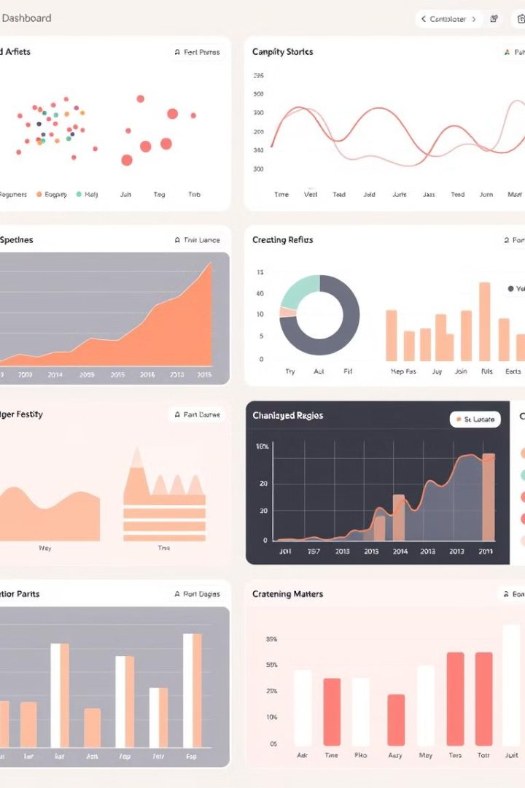
Exploratory Data Analysis (EDA)
1
Dataset Structure
2
Missing Values
Examine the first few rows to grasp the data structure. Confirm that column names are accurate and that the data types align with expectations (e.g., numerical, categorical). This ensures correct data handling.
Identify and handle missing values strategically. Decide whether to remove rows with missing data, replace missing values with a mean or median, or use more advanced imputation techniques. Justify each approach based on data characteristics.
3
Summary Statistics
Calculate summary statistics like mean, median, standard deviation, and quartiles for numerical columns. This reveals data distribution patterns, potential outliers, and central tendencies. Understand how these stats influence model selection.

Slide 4

Data Preprocessing Techniques
Categorical Encoding
Feature Scaling
Convert the categorical 'State' column into numerical format using one-hot encoding or label encoding. One-hot encoding creates binary columns for each state, while label encoding assigns a unique numerical value to each state.
Scale numerical variables if they have different ranges. Techniques like standardization or Min-Max scaling improve model performance by ensuring all features contribute equally.
Multicollinearity Check
Use VIF (Variance Inflation Factor) to check for multicollinearity among independent variables. High VIF values indicate strong correlation, necessitating the removal of one of the correlated variables.

Slide 5
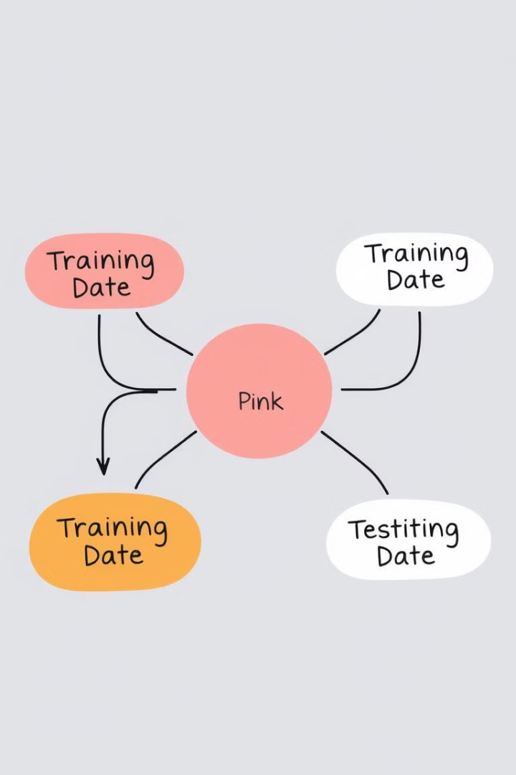
Data Splitting: Training vs. Testing
1
Training Set (80%)
The training set is used to train the machine-learning model. The model learns patterns and relationships from this data to make predictions on new, unseen data.
2
Testing Set (20%)
The testing set evaluates the model’s performance. It assesses how well the model generalizes to new data, providing insights into its accuracy and reliability. It is not used for training.

Slide 6



Model Selection and Training
Regression Model
Training
Choose a suitable regression model, such as Multiple Linear Regression, which assumes a linear relationship between independent variables and profit. Other options include polynomial regression or support vector regression.
Train the selected model using the training dataset. This involves feeding the model the input features (R&D Spend, Administration, Marketing Spend) and the corresponding profit values.

Slide 7
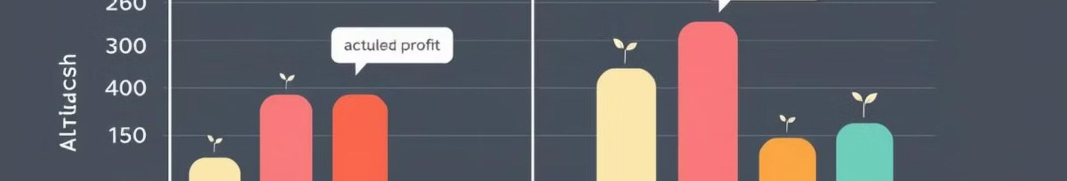



Model Evaluation Metrics
Model Performance
R-squared (R²)
Error Metrics
Check model performance on the test data by predicting profit using the test dataset. Compare predicted values against actual values to gauge accuracy.
Calculate performance metrics such as R-squared (R²), which indicates the proportion of variance in the dependent variable (Profit) that can be predicted from the independent variables.
Use error metrics like Mean Absolute Error (MAE), Mean Squared Error (MSE), and Root Mean Squared Error (RMSE) to quantify the difference between predicted and actual values, providing a measure of model accuracy.

Slide 8



Model Optimization and Improvement
Hyperparameter Tuning
Adjust the model's parameters to improve accuracy. Techniques like grid search or random search can help identify optimal parameter values.
2
Feature Selection
Refine the model by removing less important features, such as 'Administration,' if it exhibits a low correlation with profit. This simplifies the model.
1
Different Models
Explore alternative models like Decision Trees, Random Forest, or Polynomial Regression for potentially better results. Each model has unique strengths and weaknesses.
3

Slide 9



Deployment and Reporting
Interpret Results
1
Understand the impact of R&D, Marketing, and Admin on profit.
Create Dashboard
2
Visualize findings with graphs and charts.
Deploy Model
3
Enable real-time profit predictions.
Begin by interpreting the results to discern how R&D spend, marketing spend, and administration impact profit, pinpointing the factor with the highest influence. Then create a compelling report or dashboard with tools like Excel, Power BI, or Tableau to visualize your findings. Finally, deploy the trained model so you can use a programming language to save it for real-time predictions.

Slide 10

Conclusion
By following these steps, you can develop a robust model for predicting profit based on key business expenditures. Remember that the insights gained from this process can drive strategic decision-making, optimize resource allocation, and ultimately enhance profitability.
Regularly update and refine your model with new data to maintain accuracy and relevance. Continuous monitoring ensures that your profit predictions remain reliable and aligned with evolving business dynamics.

Slide 11


Slide 12

Thank You
Thank you for your time and attention today. I hope this presentation was valuable.
Lavanya R | Data & Insights

